Slide 1
Coffee shop near British Museum

Slide 2
Introduction and Data received
British Museum is the most famous museum in the world.
Spend some days in the Museum to do look the awesome items form all over the worlds for last 5000 years.
Looking for coffee shop nearby the British Museum to have better lunch and enjoy coffee, meantime can go back to Museum asap.
Use Foursquare location to find the coffee shop nearby and

Slide 3
Methodology
Based on British Museum latitude and longitude to send request to the Foursquare API to search near coffee shop name, latitude, longitude and distance to Museum.
Setup the distance about 500m.
Use pandas library to manipulated the unstructed data into structed data
Explore coffee shop by using Foilum in the map
With KMeasn cluster method to classify the coffee shops

Slide 4
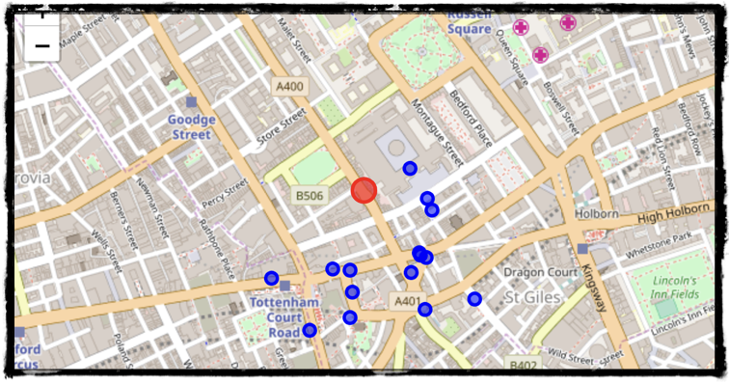

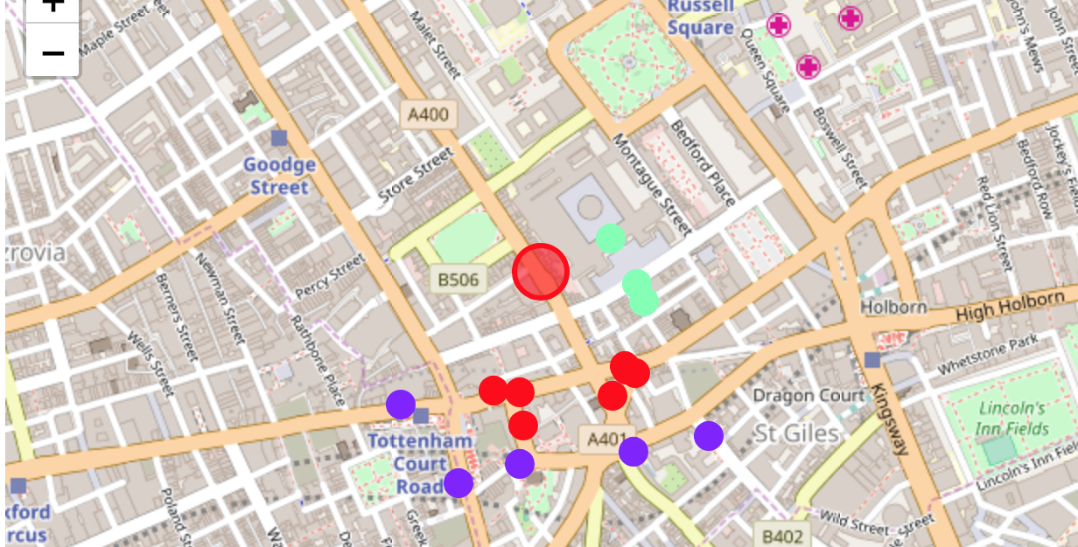
cluster

Slide 5
Result and Conclusion
Cluster0 showed that there were 7 coffee shops near the Museum, in which the distance were between 208 - 263 m.
Cluster1 showed that there were 5 coffee shops near the Museum, in which the distance were between 329 - 399 m.
Cluster2 showed that there were 3 coffee shops near the Museum, in which the distance were between 130 - 180 m.
Because I would like to try coffee from different brand or shop, I decided to go to the coffee shope in Cluster0 group, but not Starbucks and Costa Coffee. The Coffee & Gift sounds nice that I can drink coffee and also I could find some gift as well. And it is about 213 meters closed to British Museum.

